Slide 1

RAG (Retrieval-Augmented Generation)
Powered by LlamaIndex
Dr Maria Prokofieva

Slide 2

What we will cover
Limitations of LLMs
What is RAG
RAG architecture
RAG components
Applications and challenges

Slide 3

What’s wrong with LLMs
“Timed” knowledge:
Traditional LLMs are trained on large datasets up to a certain point in time.
No updates since training
Problem: How to retrieve and incorporate the most recent and relevant information from external sources?
Lack knowledge in niche topics
LLM is trained on extensive but broad data
Problem 1: How to incorporate precise data with a vast corpus of documents?
Problem 2: How to make retrieved information more context-aware and relevant?

Slide 4

What’s wrong with LLMs
Hallucinations: LLMs sometimes generate plausible but incorrect information
Problem: How to incorporate factual data from external sources?
Multi-domain applicability:
Problem: How to make models to operate across various domains, especially those where specific, up-to-date information is crucial, such as legal, medical, or technical fields?
LLMs are… LARGE and retraining is expensive!
Problem: How to incorporate LARGE external data without retraining?

Slide 5

Solution: RAG
augmenting LLM knowledge with additional data
Retrieval:
searching for and extracting relevant information from a large corpus, database, or knowledge base.
Augmented:
enhanced or supplemented with additional information or capabilities
Generation:
creation or production of text from the model based on input data and learned patterns.

Slide 6

Steps
Retrieval:
identifying and pulling in specific documents, passages, or data points that are relevant to the user's query.
Augmented:
using the retrieved information to improve the generation process.
the model's internal knowledge is “augmented”
Generation:
the model generates output by synthesizing the retrieved data with its own language understanding

Slide 7

Stages in RAG
Indexing
a pipeline for ingesting data from a source and indexing it.
This usually happens offline.
Retrieval and generation:
the actual RAG chain, which takes the user query at run time and retrieves the relevant data from the index, then passes that to the model.

Slide 8
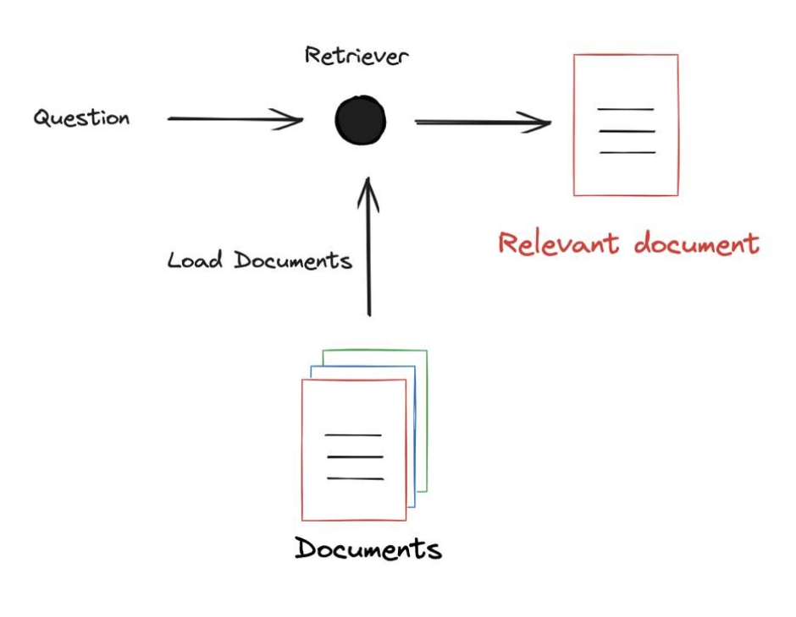
RAG workflow

Slide 9

Indexing
Established concept in the context of information retrieval, databases, and search engines
The process of organizing and structuring data in a way that makes it easy and efficient to search, retrieve, and access relevant information
Or
= searchable database of information

Slide 10
Indexing​
Data Collection & Preprocessing
Gather and clean the data for indexing.
Tokenization
Break down text into tokens (words/subwords).
Text Representation
Convert tokens into vectors using methods like embeddings.
Inverted Index Creation
Build an index mapping tokens to document locations.
Index Optimization
Compress and prune the index for efficiency.
Integration
Connect the index to a search engine and set up ranking.
Store
Test and validate the index for accuracy and performance.

Slide 11
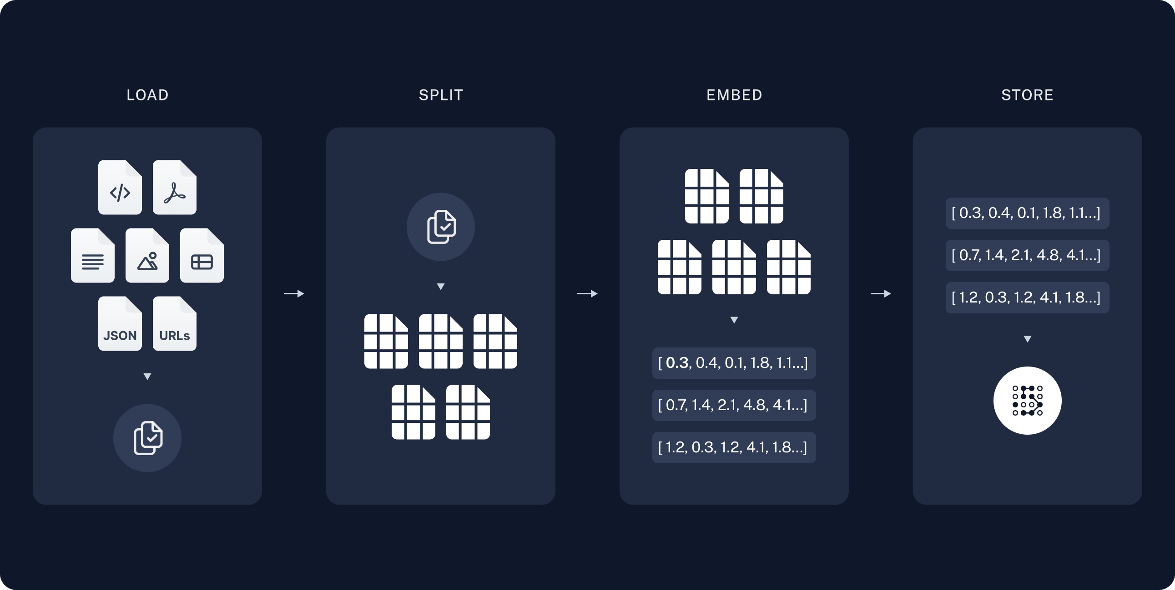
Indexing​

Slide 12
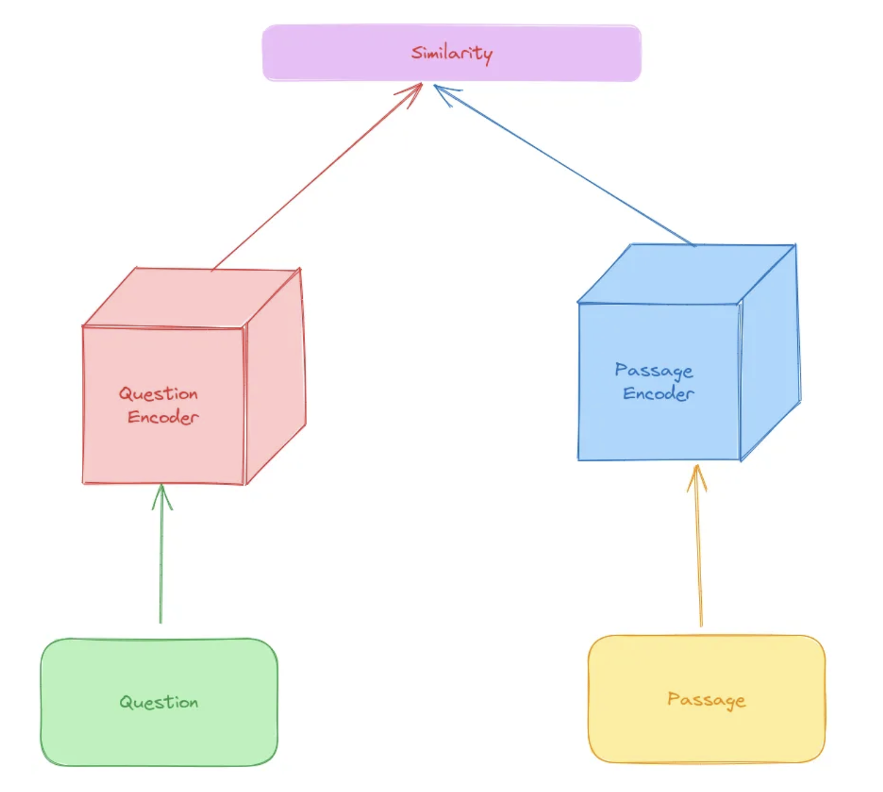
The Retrieval Component
Retriever Model: Dense Passage Retriever (DPR)
Dual-Encoder Architecture:
Query (question) encoder: Converts the input query into a dense vector representation.
Document (passage) Encoder: Converts each passage/document in the corpus into dense vectors.
Similarity Search: Matches the query vector against document vectors to find the most relevant passages.

Slide 13
How Retrieval is Performed on a Large Corpus
Step 1: Preprocessing
Tokenize and encode the entire document corpus into dense vectors.
Store vectors in a high-performance search index (e.g., FAISS).
Step 2: Query Encoding
Input query is tokenized and encoded into a dense vector using the query encoder.
Step 3: Similarity Search
Perform nearest-neighbor search to find the top-N most similar document vectors in the index.
Step 4: Passage Selection
Retrieve and rank passages based on their relevance to the query.

Slide 14

The Generation Component
A generative model to incorporate the content of the retrieved passages into the generation process:
BART:
bidirectional
encodes both the query and the retrieved passages together
GPT:
uses the retrieved passages as part of the input context and generates a response by predicting the next token in a sequence
checks that the generated text remains aligned with the content of the passages.

Slide 15

Applications of RAG
Open-domain Question Answering: Providing accurate answers from large knowledge bases.
Knowledge-Enhanced Dialogue Systems: Improving chatbot responses with external data.
Fact-Checking: Verifying information using external sources.

Slide 16

Advantages of RAG
Enhanced accuracy through the integration of external knowledge.
Flexibility in adapting to various NLP tasks.
Improved performance in comparison to purely generative models.

Slide 17

Challenges and Considerations
Computational complexity and resource requirements.
Potential challenges in training and fine-tuning.
Ethical considerations when using RAG for sensitive information retrieval.

Slide 18

Let’s practice

